Slide 1
Shift of Acetaminophen Dosages on Liver, Kidney, and Nerve Cells
Abby Kate Miller
Medicine and Health
Rockdale Magnet School for Science and Technology

Slide 2
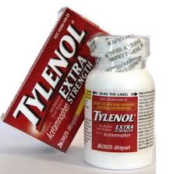
Acetaminophen
Common painkiller sold over the counter.
1970’s- Doctors named Acetaminophen the safest possible over the counter drug.
Acetaminophen works to relieve pain caused by conditions such as headache, osteoarthritis, muscle pain, and to reduce fever caused by infection (Acetaminophen 2008).
2011- Acetaminophen named the most dangerous over the counter drug.
Number 1 use to commit suicide (Acetaminophen, 1979).

Slide 3
The Idea
Why do people still continue to take off label dosages of Acetaminophen when the hazards are clearly labeled on the bottle?
Do they know what will happen to their body if they continue to take over dosages of this dangerous pain killer?

Slide 4
Hypothesis
Main hypothesis: Acetaminophen applied at irregular dosage amounts would have a noticeable effect on the cells.
Null hypothesis: There will be no noticeable affect on the cells.

Slide 5
Types of Cells Used

Slide 6
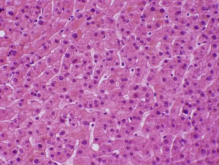
Liver Cells - Rat
Vital organ that takes part in many metabolic processes.
Photo Source: Bing images

Slide 7
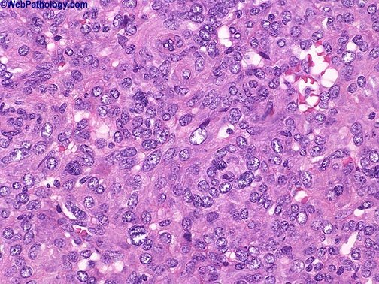
Kidney Cells - Rat
Removes waste.
Photo Source: Bing images

Slide 8
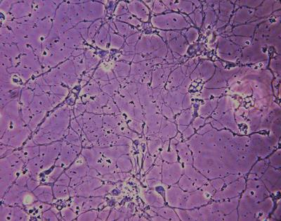
Nerve (Neuron) Cells - Rat
Transmits signals throughout the body.
Photo Source: Bing images

Slide 9
Procedure

Slide 10
Day 1: Sterilizing and Making Treatments
Four different treatments of Acetaminophen were mathematically calculated for cell dosage.
Control, Low, Medium, and High treatments.
Treatments were sterilized, labeled, and left in the lab refrigerator.

Slide 11
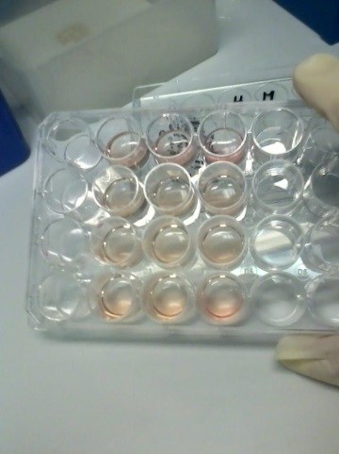
Day 2: Incubating Cells in Treatments
Treatments warmed and inserted into well plate.
Cells inserted into treatment wells and given cell growth.
Incubated overnight.
This day was repeated for all 3 typed of cells.
Photo Source: Abby Miller

Slide 12
Day 3: Counting the Cells
Cell growth discarded.
Trypsin added to pull cells off the bottom of the well.
Samples taken of each well.
Trypan blue added to dye the dead cells blue.
10 µl put into each side of a hemacytometer.
Cells counted under a microscope.
Data collected.
Aseptic technique to clean up area and cells.

Slide 13
Data

Slide 14
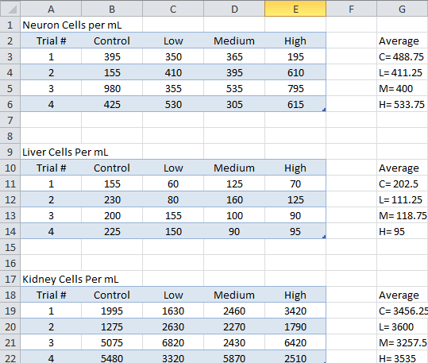
Raw Data

Slide 15
Graph (Averages)
Clear trend in the data; statistically significant with a p-value of 0.005

Slide 16
No clear trend in the data; not statistically significant.

Slide 17
Somewhat of a trend in the data; not statistically significant.

Slide 18
Data Analysis
Main and Null hypothesis supported.
There was a noticeable effect on the Liver and Nerve cells.
There was no noticeable effect on the Kidney cells.
Acetaminophen has a noticeable harmful effect on the liver and nerve cells.

Slide 19
What Does This Mean?
Acetaminophen can be harmful and have long term effects.
It is dangerous to take off label dosages of Acetaminophen.

Slide 20
Future Research
Get the word of these findings to the public.
Experiment on different organisms cells.

Slide 21
Literature Cited
Acetaminophen. (2013, March 25). Retrieved from http://www.nlm.nih.gov/medlineplus/druginfo/meds/a681004.html
Brown, M. (1984). Development of nerve cells and their connections. (1st ed.). New York, NY: Cambridge University Press. Retrieved from http://books.google.com/books?id=k_03AAAAIAAJ&printsec=frontcover&dq=nerve cells&hl=en&sa=X&ei=JaZPUafhIIrO9ASL5IHoDQ&ved=0CFIQ6AEwBQ
Charand, K. (n.d.). Nerve cell. Retrieved from http://hyperphysics.phy-astr.gsu.edu/hbase/biology/nervecell.html
DE, R., C von, B., H, G., P, M., & A, R. (1979). Acetaminophen: potentially toxic metabolite formed by human fetal and adult liver microsomes and isolated fetal liver cells. Science, 205(4413), 1414-1416. Retrieved from http://www.sciencemag.org/content/205/4413/1414.short
Knight , T., & Farwood, A. (2002). Mode of cell death after acetaminophen overdose in mice: Apoptosis or oncotic necrosis?. Toxicological Sciences, 67(2), 322-328. Retrieved from http://toxsci.oxfordjournals.org/content/67/2/322.full
Lodish. (1986). Molecular cell biology. (6th ed.). New York, NY: W. H. Freeman and Company. Retrieved from http://books.google.com/books?id=K3JbjG1JiUMC&pg=PA472&dq=stomach cells&hl=en&sa=X&ei=PaZPUau3CYy-9QSjsYGoBA&ved=0CC0Q6AEwAA
Mcneil. (2012). How to read a drug facts label. Retrieved from http://www.getreliefresponsibly.com/safely/label.php
Murray, G. (n.d.). Heparg cells: A human model to study mechanisms of acetaminophen hepatotoxicity. (2011). Retrieved from http://www.ncbi.nlm.nih.gov/pmc/articles/PMC3073317/
Rosenberger, E. (2009, July 9). The health risks of actaminophen/tylenol. Retrieved from http://voices.yahoo.com/the-health-risks-acetaminophen-tylenol-3768634.html
Taub, M. (1990). Primary kidney cells. PubMed, (5), 189-196. Retrieved from http://www.ncbi.nlm.nih.gov/pubmed/21374126

Slide 22
Achievements
A/B Honor Roll- This has taught me the importance of time management along with balancing sports and maintaining good grades.
MASA Vice President- This has taught me the importance of teamwork and has also increased my leadership skills.

Slide 23
Shift of Acetaminophen Dosages on Liver, Kidney, and Nerve Cells
Questions?

